Slide 1

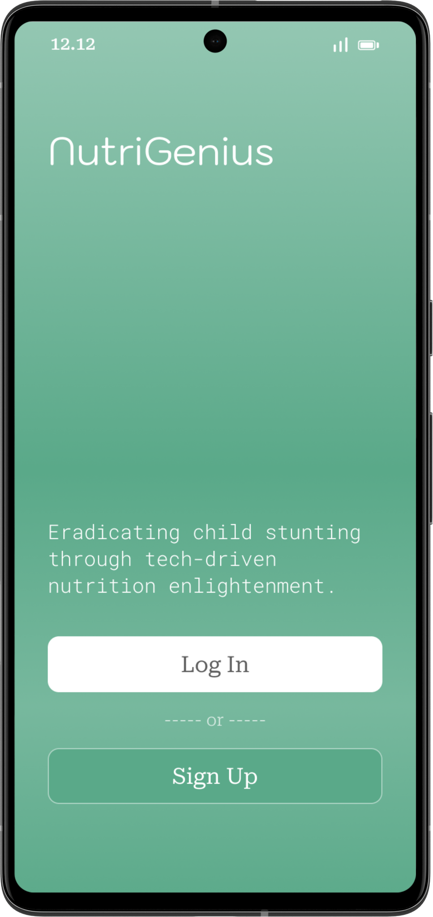



Solution to The Stunting Problem in Indonesia Human Healthcare and Living Wellbeings Product-Based Project

Slide 2





CH2-PR635 Team
Teuku N. Puteh
A314BSY2063
Mobile Development
Fiqri Rasyidiq
M302BSY0936
Machine Learning
M. Ahnaf Zalfa
M214BSY1912
Machine Learning
Rizqi Santriani
C156BSX3410
Cloud Computing
As’ad Reza A
C676BSY3624
Cloud Computing
Pieter Rafael Johansz
C006BSY3921
Cloud Computing

Slide 3
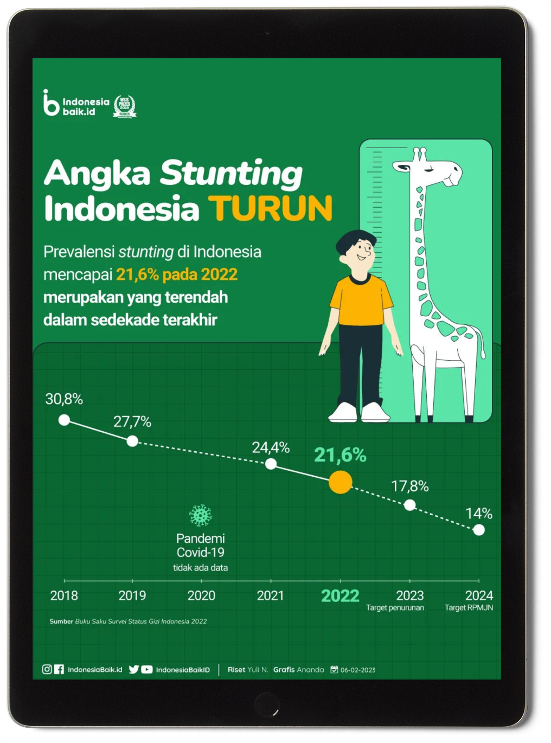
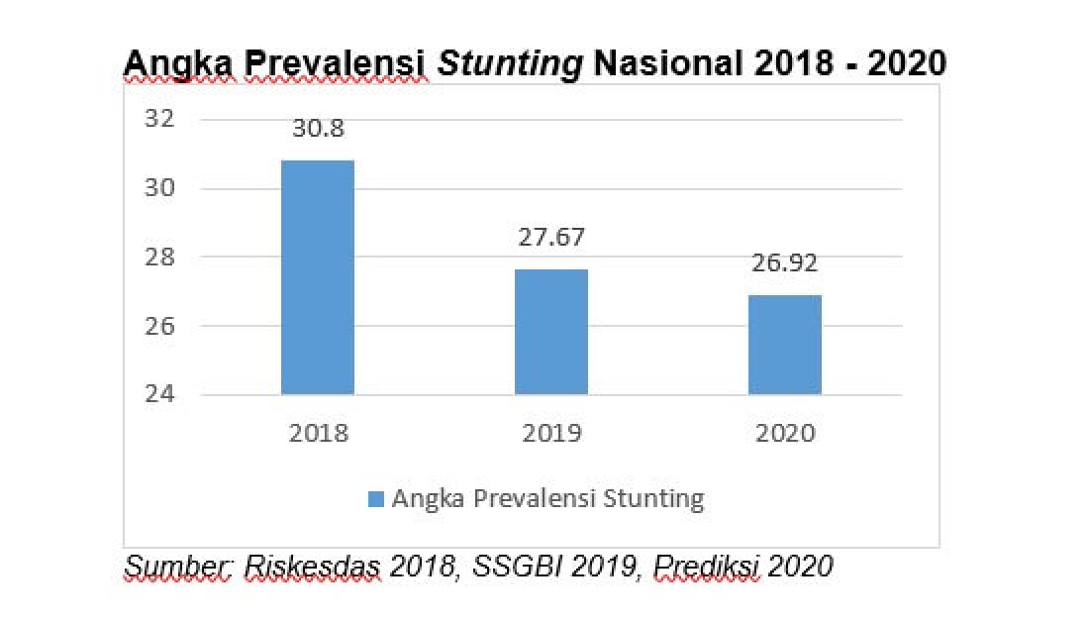
Background
Stunting is a nutritional problem that needs special treatment, especially in poor and developing countries. Literally, stunting is a condition of failure to grow in children under five caused by chronic nutritional deficiencies and the inability to meet the child's nutritional standards.
Based on research data from the Ministry of Health, before the emergence of the COVID-19 pandemic, around 6.3 million toddlers out of Indonesia's total toddler population of 23 million experienced stunting. In fact, the prevalence of stunted toddlers in Indonesia in 2019 reached 27.7%. This puts Indonesia in fourth place globally as the country with the highest cases of stunting.

Slide 4



Why should we put a caution on this stunting case?
Human Rights
Economic
Reputation
If left unchecked for a long time, Indonesia will indirectly ignore human rights in terms of the welfare of its people.
Stunting will have an impact on the country's economic progress due to inadequate human resources.
Indonesia has the potential to get a bad reputation in the international world, which is correlated with stunting cases which are still high.
SIMILAR APPS

Slide 5

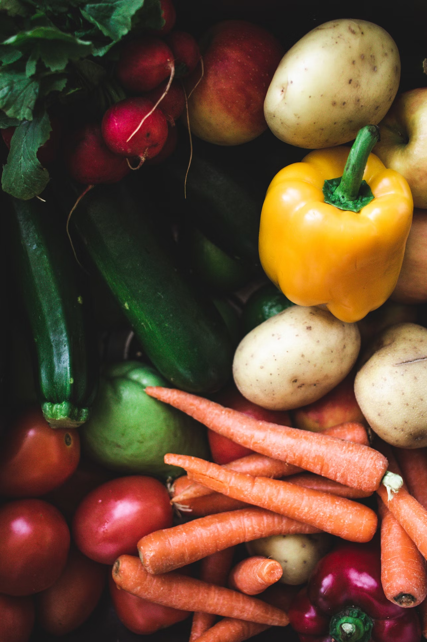

Existing Result
Of course, all parties involved want to create new breakthroughs to reduce the frequency of stunting in Indonesia. Various efforts have been made to achieve this. In our group, we take the initiative to differentiate through certain features:
Food scanning feature that shows the nutritional levels contained
Article features as a form of education for parents
Consultation feature with nutrition experts to obtain constructive recommendations
Our group feels that these three points are still rarely found in other product prototypes. The hope is that the features described above will maximize the real reduction in stunting in Indonesia.
Food Scanner
SIMILAR APPS
Nutrition Monitoring
Stunting Detection

Slide 6
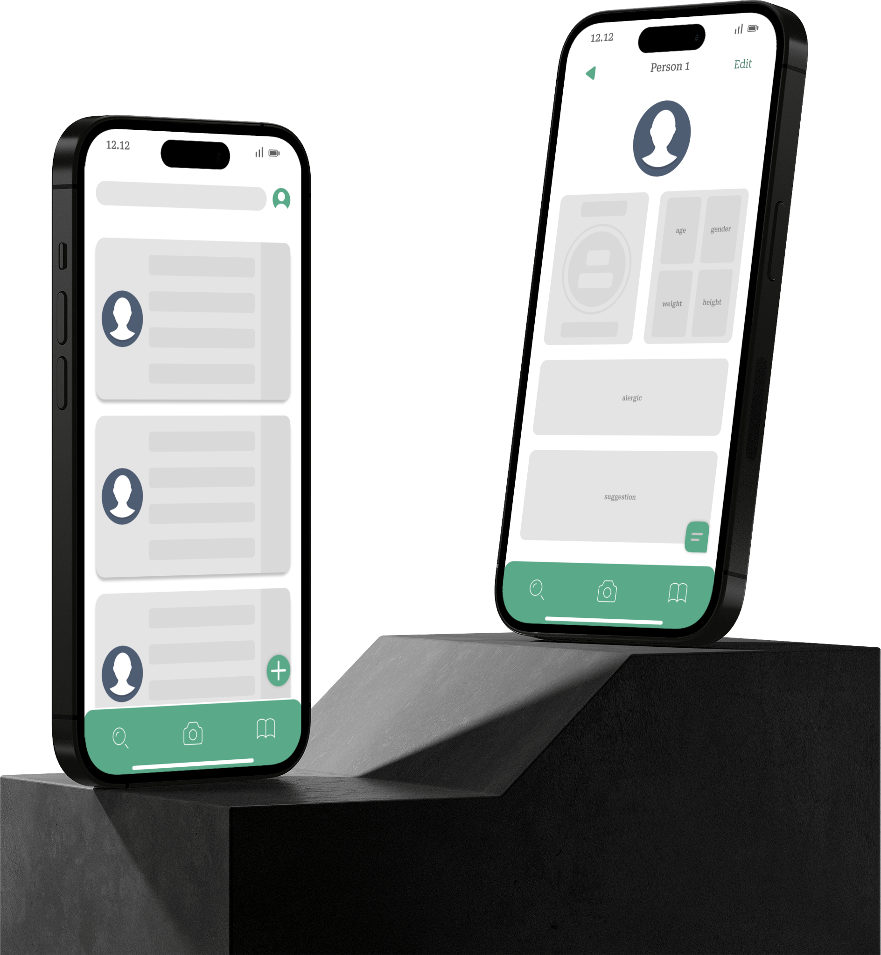

Nutrition Monitoring
provides recommendations for balanced menus and nutritious food recipes according to the nutritional status data entered. Users can also obtain information regarding the urgency of certain nutritional intake for children's optimal growth.
Is an innovative project that aims to overcome the problem of stunting in Indonesian children through a combination of technology and nutrition education.

Slide 7

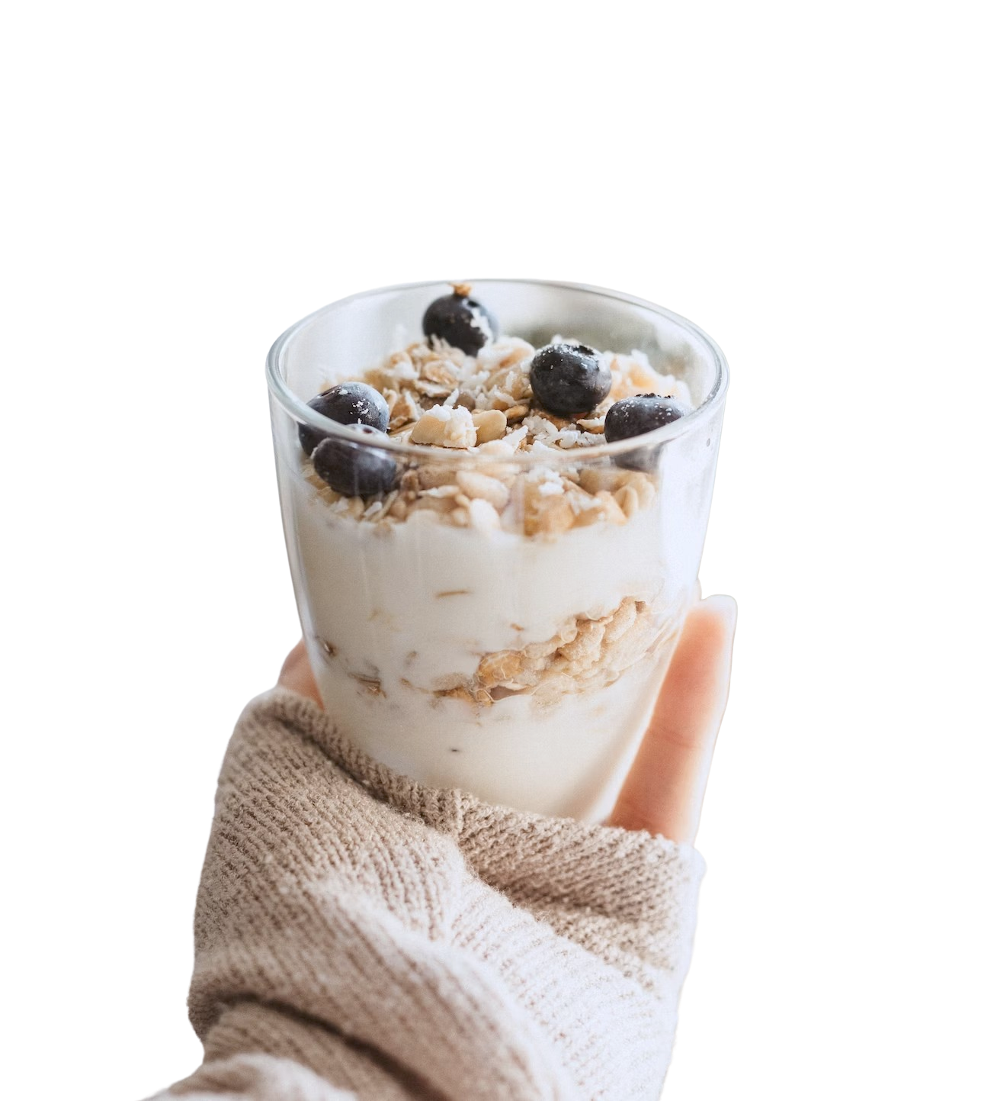

Nutrition Monitoring
Recommendations Feature
Provides recommendations for balanced menus and nutritious food recipes according to the nutritional status data entered. Users can also obtain information regarding the urgency of certain nutritional intake for children's optimal growth.
provides recommendations for balanced menus and nutritious food recipes according to the nutritional status data entered. Users can also obtain information regarding the urgency of certain nutritional intake for children's optimal growth.

Slide 8

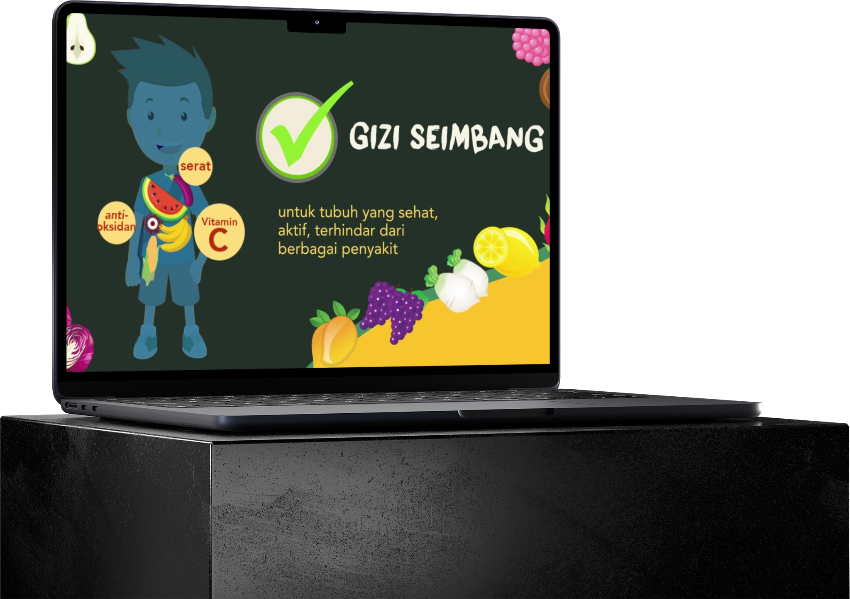
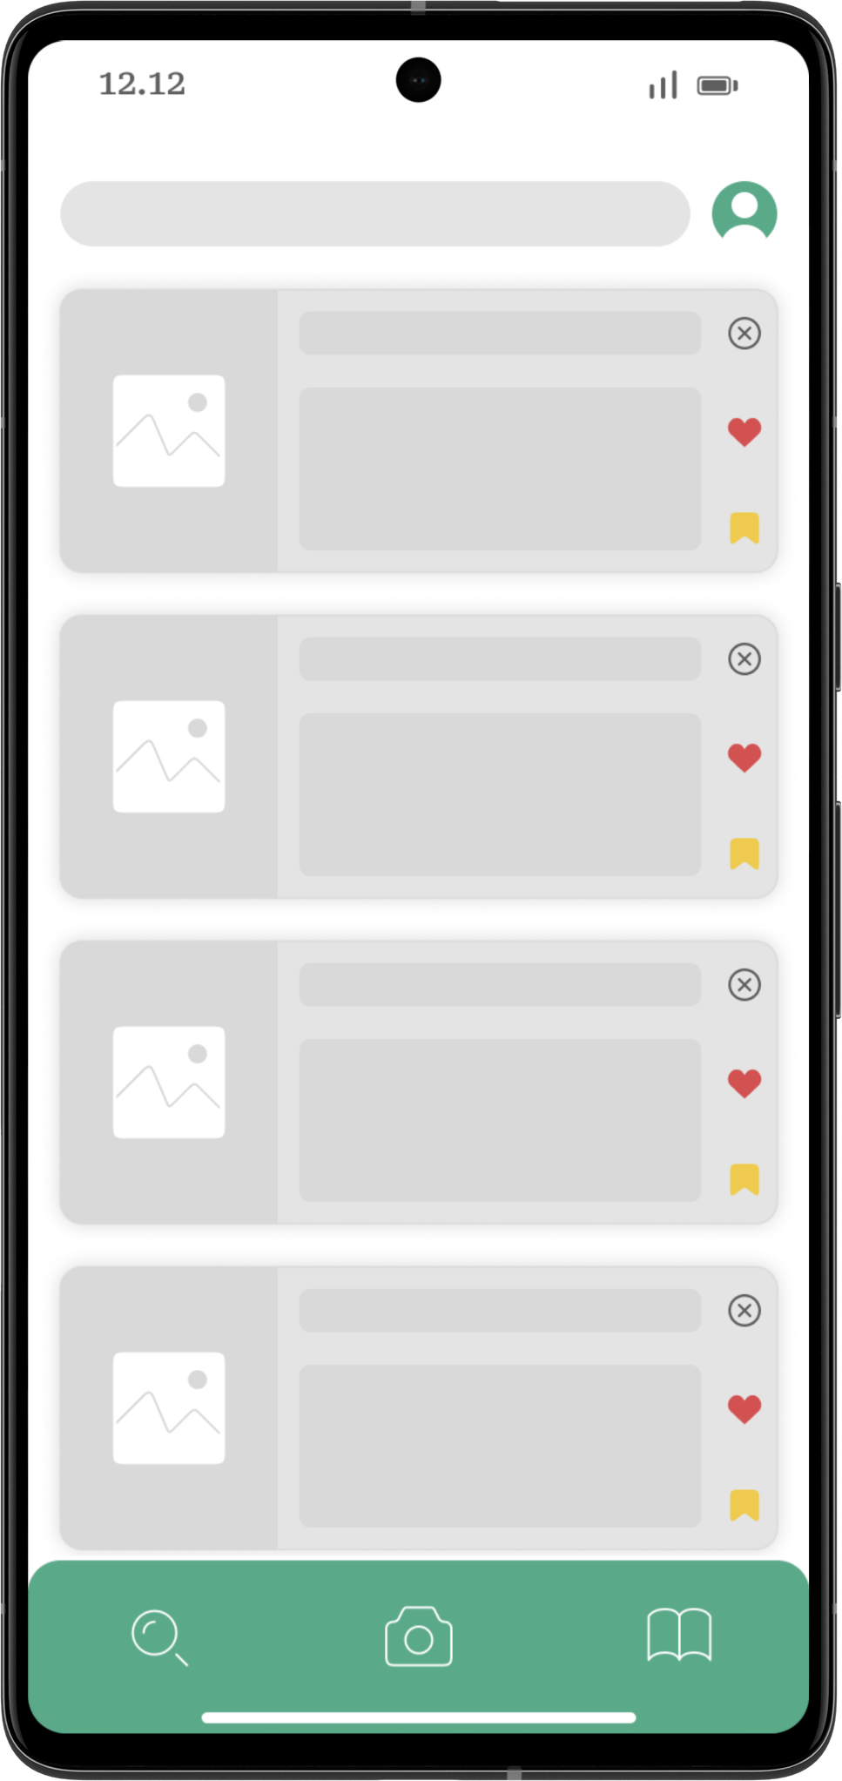
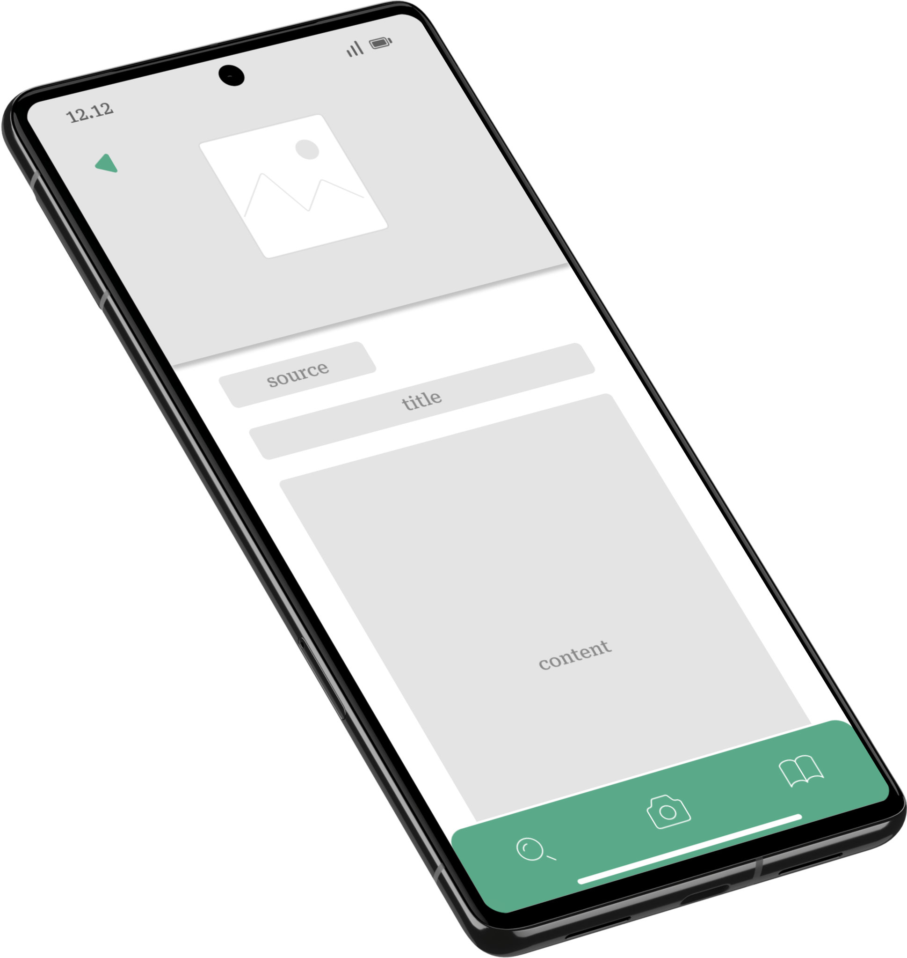
Recommendations Feature
Provides recommendations for balanced menus and nutritious food recipes according to the nutritional status data entered. Users can also obtain information regarding the urgency of certain nutritional intake for children's optimal growth.

Slide 9

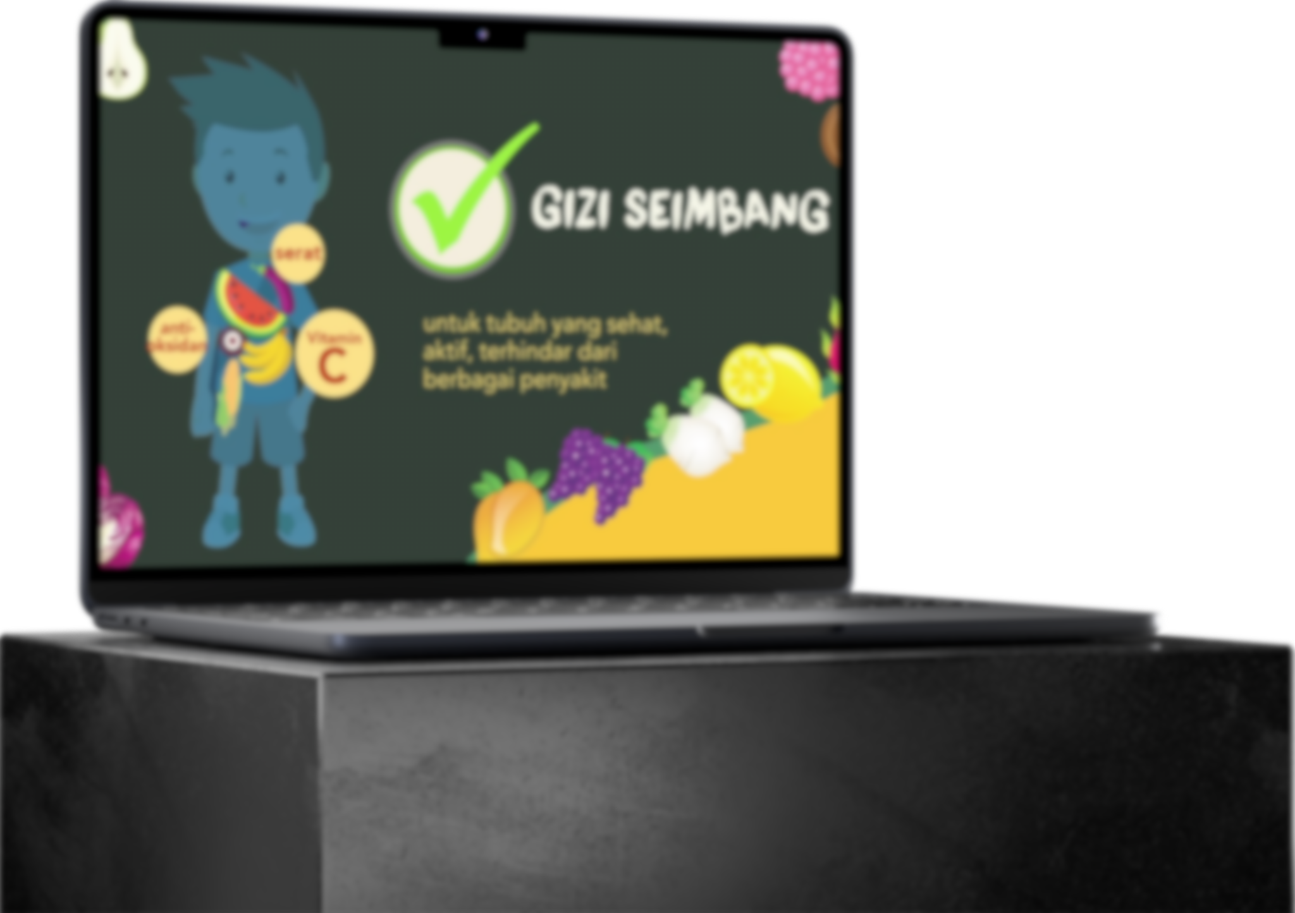

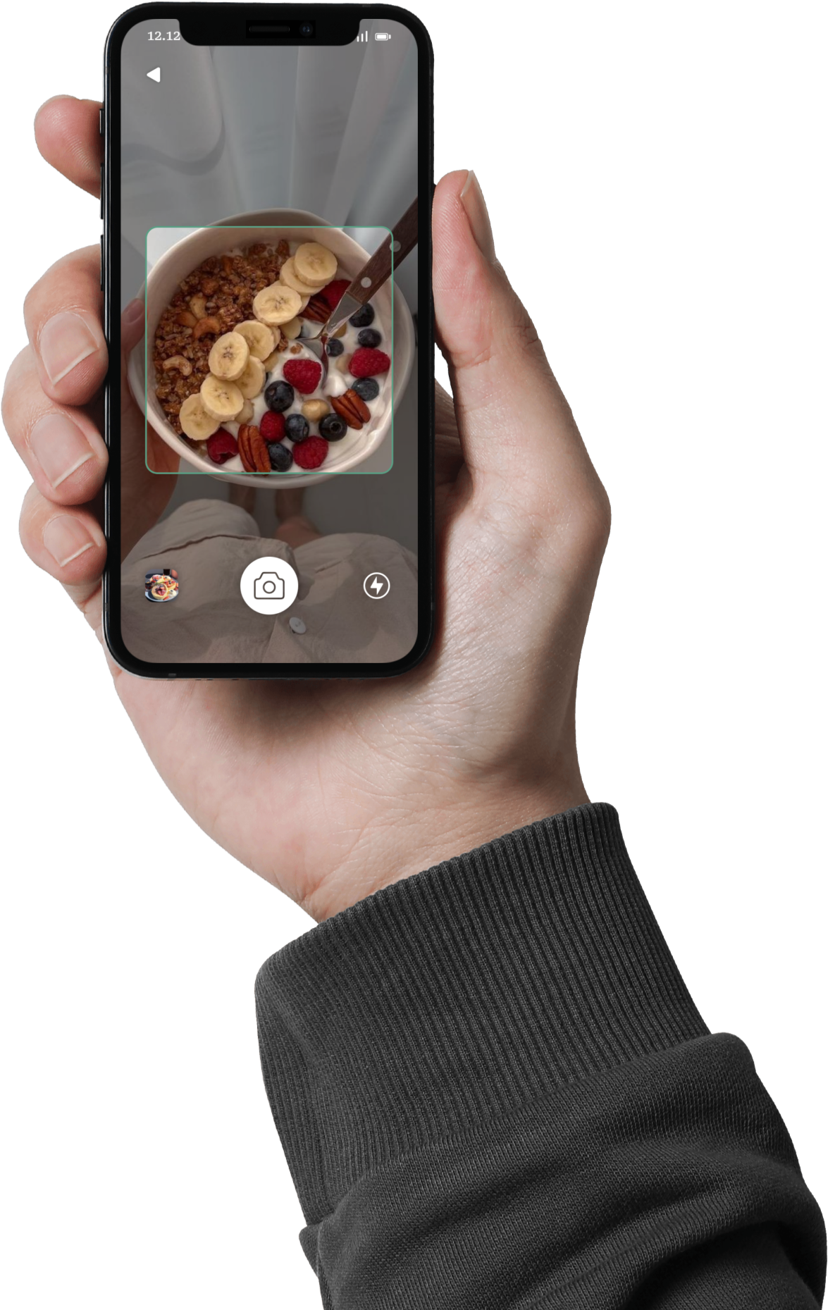
Nutrition Education
Provides health articles and educational information about nutrition to help inspire parents to understand their children's nutritional needs.
Scanning Food
Provides food photo-taking services using cell phone cameras; The application will automatically identify types of food and provide an overview of their nutritional composition, making it easier for users to make wise decisions regarding their child's growth and development.

Slide 10




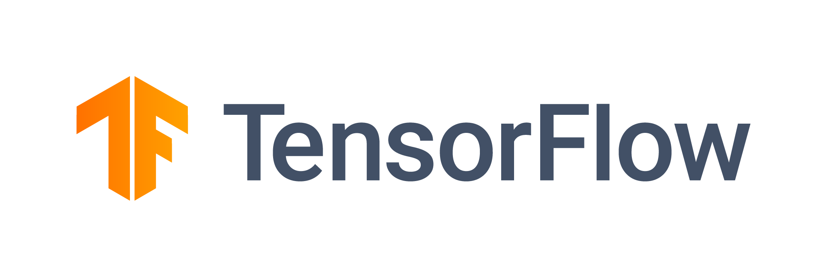
Scanning Food
Provides food photo-taking services using cell phone cameras; The application will automatically identify types of food and provide an overview of their nutritional composition, making it easier for users to make wise decisions regarding their child's growth and development.

Slide 11


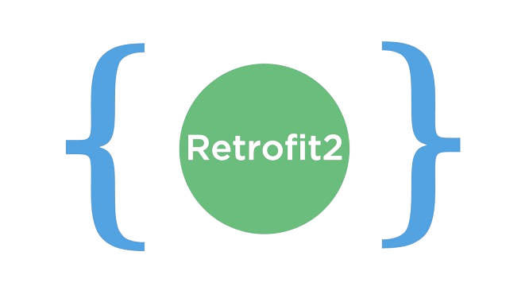

Scanning Food
Provides food photo-taking services using cell phone cameras; The application will automatically identify types of food and provide an overview of their nutritional composition, making it easier for users to make wise decisions regarding their child's growth and development.
Implement
This project not only includes the development of machine learning models, but also focuses on data understanding and exploration of various algorithms. The integration of TensorFlow allows exploration into deep learning approaches that can improve model performance beyond traditional models.

Slide 12






Implement
A mobile application developed with a focus on using the latest tools in mobile development. The app aims to provide an intuitive and engaging user experience in recording and organizing daily life.

Slide 13
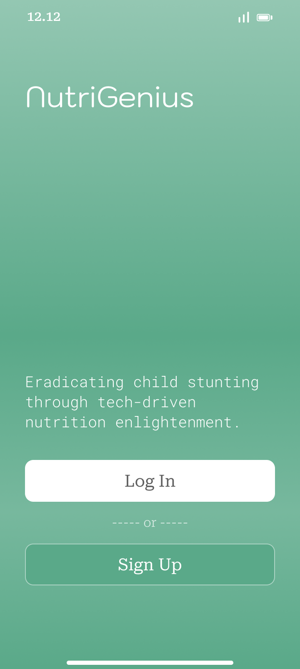
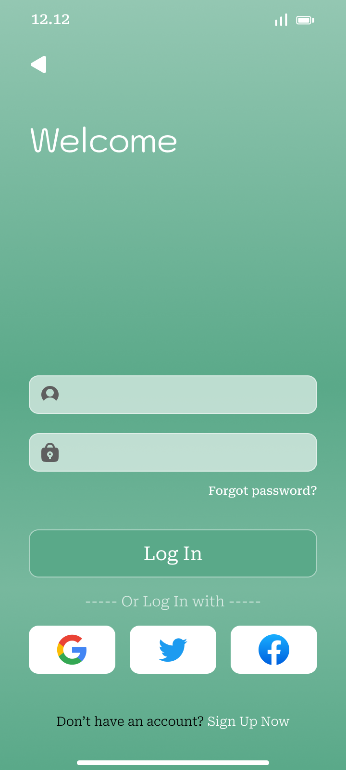
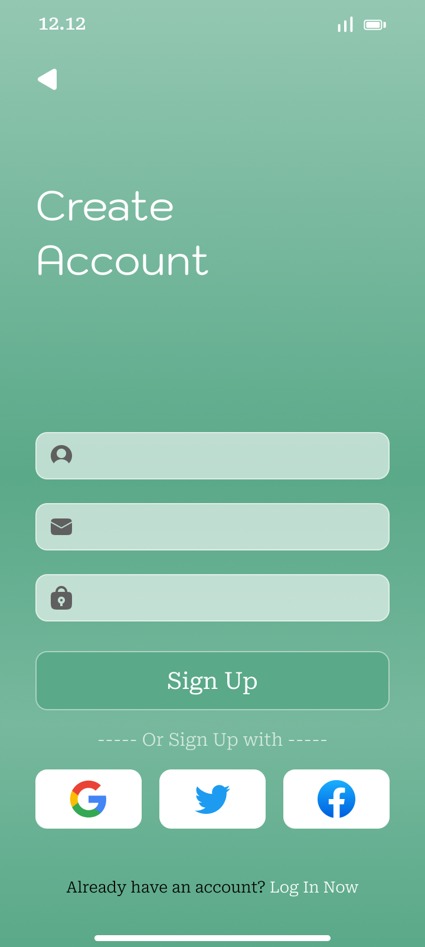
Implement
This project demonstrates the robust integration between Node.js, Firebase, and Google Cloud Platform to provide a stable, scalable, and user-friendly cloud solution for team task management.
Login / Signup

Slide 14

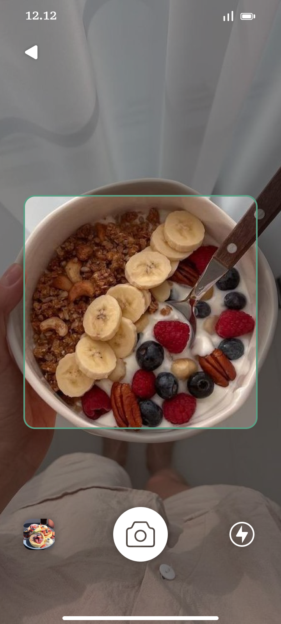
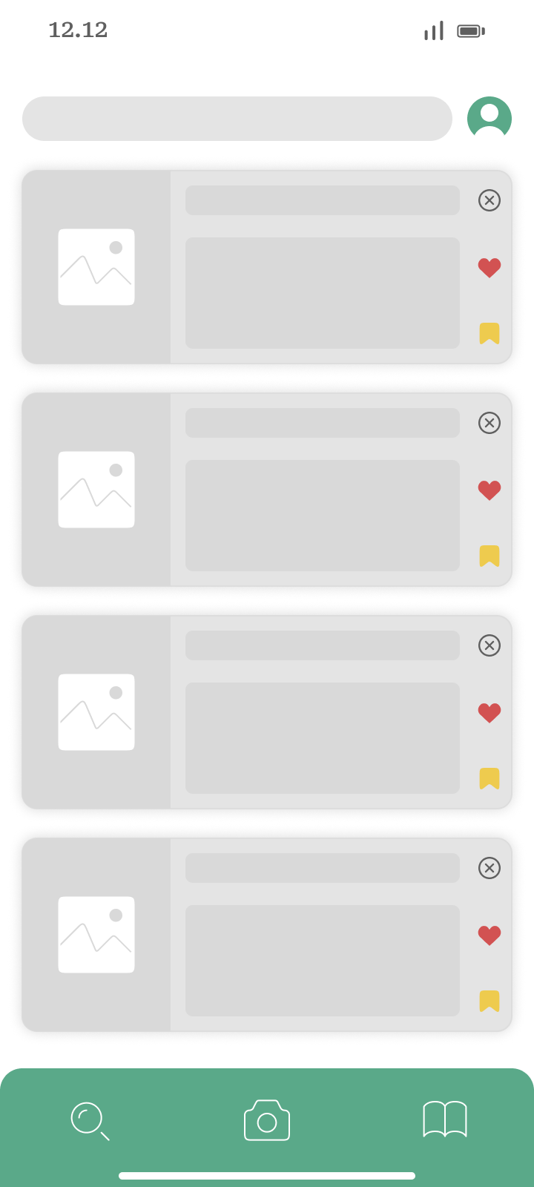
Result & Documentation
Login / Signup
Monitoring / Scanning / Article

Slide 15

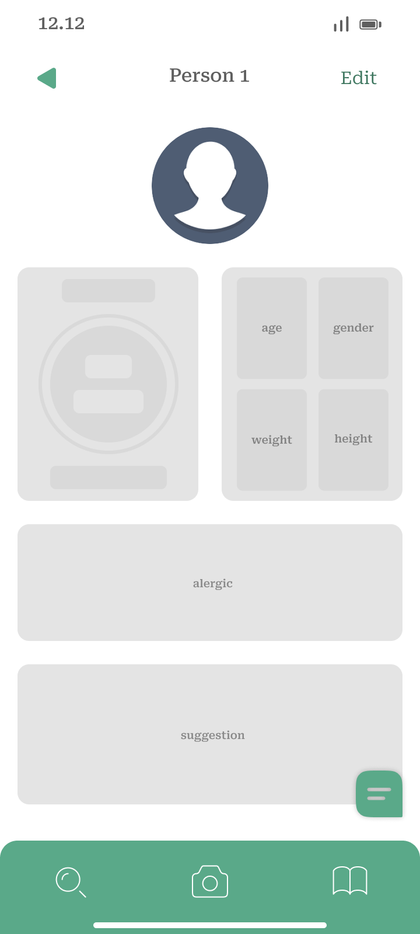

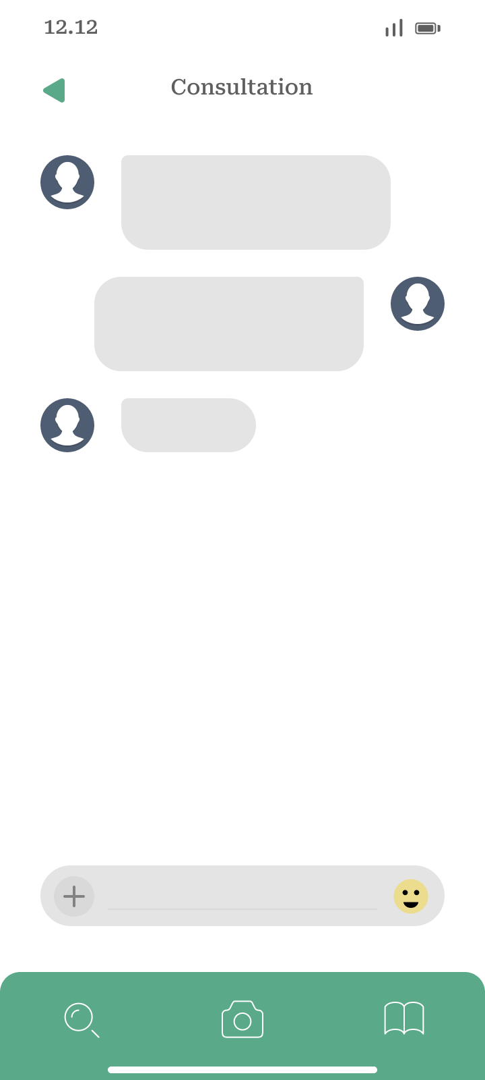
Login / Signup
Result & Documentation
Monitoring / Scanning / Article
Monitoring List / Monitoring Add / Monitoring Detail / Monitoring Edit / Consultation

Slide 16
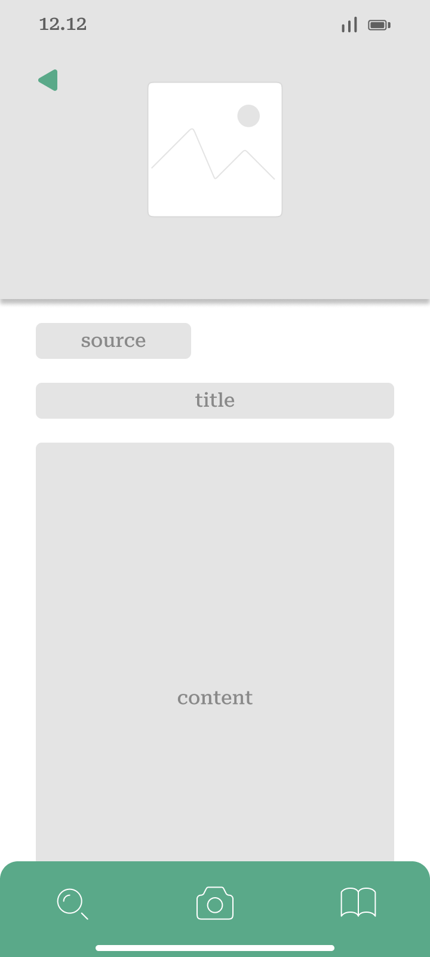
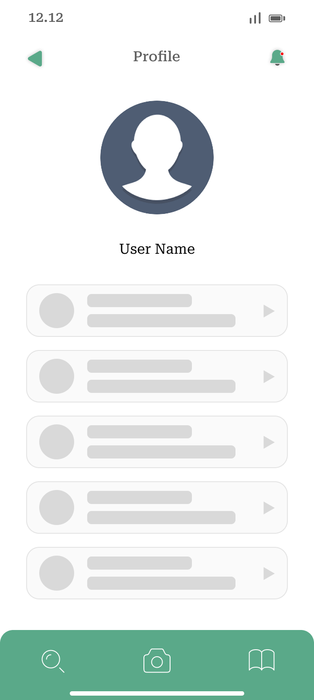
Monitoring / Scanning / Article
Result & Documentation
Monitoring List / Monitoring Add / Monitoring Detail / Monitoring Edit / Consultation
Article / Article Detail / Profile

Slide 17

Monitoring List / Monitoring Add / Monitoring Detail / Monitoring Edit / Consultation
Result & Documentation
Article / Article Detail / Profile
In strategizing the local deployment of NutriGenius, we're meticulously engaging key stakeholders, aligning with local health authorities and community organizations. Our focus includes optimizing the app for local infrastructure, ensuring a smooth integration process. With a user-friendly onboarding system in place and community-centric engagement initiatives, we aim to create widespread awareness and accessibility.
Simultaneously, our business pitch emphasizes NutriGenius's value, highlighting user-friendly features, real-time monitoring, and positive impacts on childhood nutrition. The go-to-market proposal entails a targeted marketing approach, competitive pricing, and strategic partnerships with local institutions for extended outreach. This comprehensive strategy is designed to seamlessly introduce NutriGenius to the local community, aligning with their needs and promoting sustainable health initiatives.

Slide 18



Article / Article Detail / Profile
Deployment and Business Pitch
In strategizing the local deployment of NutriGenius, we're meticulously engaging key stakeholders, aligning with local health authorities and community organizations. Our focus includes optimizing the app for local infrastructure, ensuring a smooth integration process. With a user-friendly onboarding system in place and community-centric engagement initiatives, we aim to create widespread awareness and accessibility.
Simultaneously, our business pitch emphasizes NutriGenius's value, highlighting user-friendly features, real-time monitoring, and positive impacts on childhood nutrition. The go-to-market proposal entails a targeted marketing approach, competitive pricing, and strategic partnerships with local institutions for extended outreach. This comprehensive strategy is designed to seamlessly introduce NutriGenius to the local community, aligning with their needs and promoting sustainable health initiatives.
Parents / Caregivers
Health Instructor / Personal Trainer
Medical Workers

Slide 19





Target Market
Getting investors
Expand the market and adding more features
Parents / Caregivers
Health Instructor / Personal Trainer
Medical Workers
Successfully implement the product and getting first customer
Get a collaborations with government
In strategizing the local deployment of NutriGenius, we're meticulously engaging key stakeholders, aligning with local health authorities and community organizations. Our focus includes optimizing the app for local infrastructure, ensuring a smooth integration process. With a user-friendly onboarding system in place and community-centric engagement initiatives, we aim to create widespread awareness and accessibility.
Simultaneously, our business pitch emphasizes NutriGenius's value, highlighting user-friendly features, real-time monitoring, and positive impacts on childhood nutrition. The go-to-market proposal entails a targeted marketing approach, competitive pricing, and strategic partnerships with local institutions for extended outreach. This comprehensive strategy is designed to seamlessly introduce NutriGenius to the local community, aligning with their needs and promoting sustainable health initiatives.

Slide 20
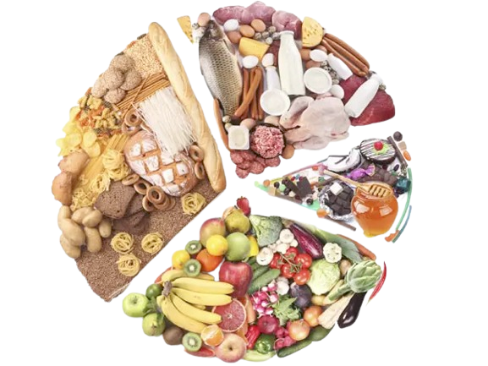
Project Milestone
Getting investors
Expand the market and adding more features
Successfully implement the product and getting first customer
Get a collaborations with government
Parents / Caregivers
Health Instructor / Personal Trainer
Medical Workers

Slide 21
Thank You!

